Slide 1
What is statistics good for?
Brian Caffo, Jeff Leek, Roger Peng
@bcaffo
www.bcaffo.com

Slide 2
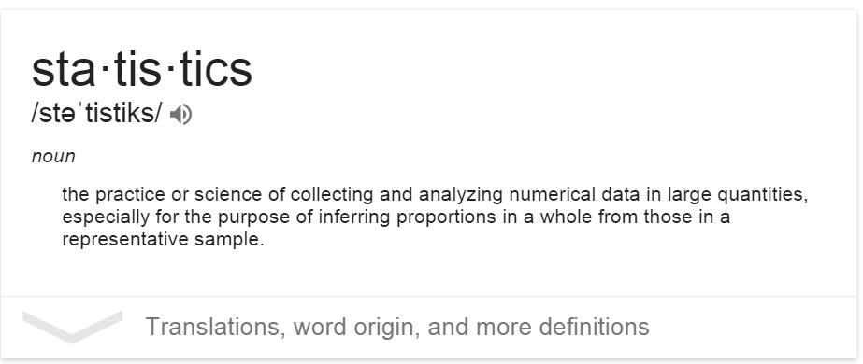
What if I ask google?

Slide 3
Definition by core activities
Let’s take a different tact in defining the field by categorizing the core activities
Descriptive analysis (EDA, quantification, summarization, clustering)
Inference (estimation, sampling, variability, defining populations)
Prediction (machine learning, supervised learning)
Design (the process of designing experiments)

Slide 4
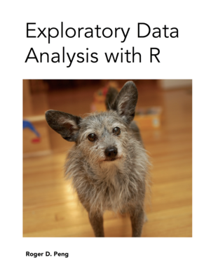
Descriptive analysis

Slide 5
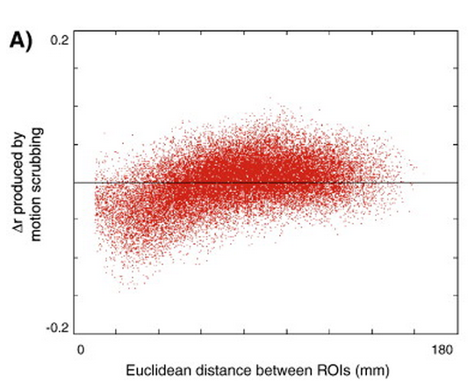
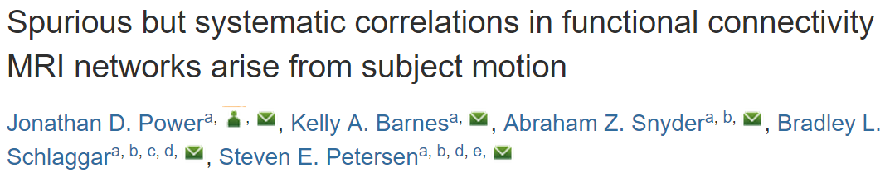
Example

Slide 6
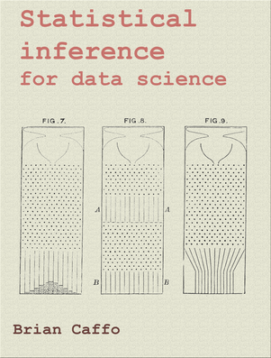
Inference

Slide 7
Inference
Statistical inference - the process of making conclusions about populations from a sample

Slide 8
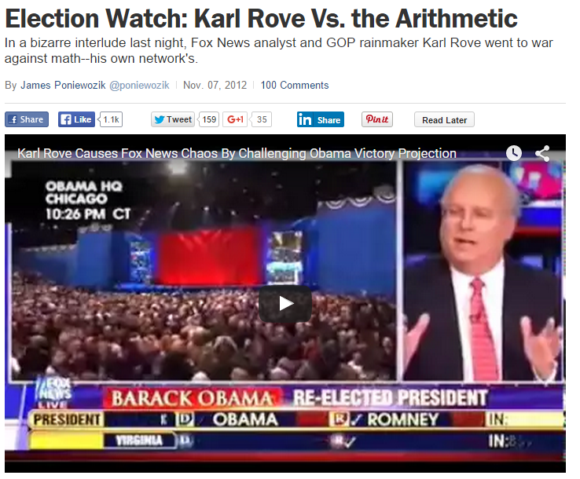
Election polling

Slide 9
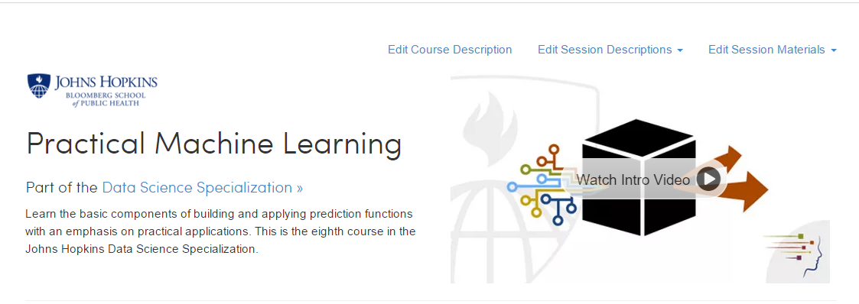
Prediction

Slide 10

Prediction
http://www.stock-market-crash.net/wp-content/uploads/2012/06/Black-Monday-the-Stock-Market-Crash-of-1987-NYT.jpg

Slide 11
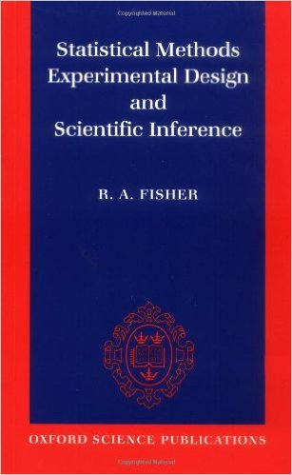
Design

Slide 12
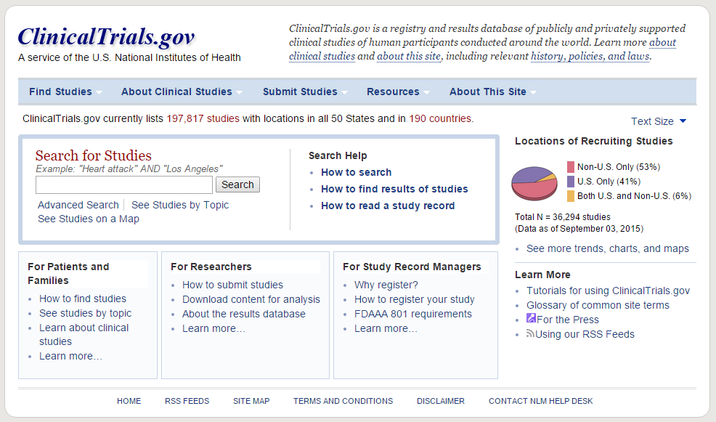
Clinical trials

